Slide 1

2020.09.24.TUE

Slide 2
MAD-5234 Software Quality Assurance Testing
This course is an introduction to the principles of software quality assurance
Software Testing:
A procedural set of activities
Automated Testing:
Keep it simple:
Assert statement
Graphical User Interfaces:
Manual testing / check-list
User Experience UX
Software Quality Assurance
Software Quality Engineering
A way of thinking about the what the software development process IS and how it works
TEST CASE DRIVEN
Validation
Design / Structuring
Tests, Tractability Matrix
Since we need to write tests, Traceability Matrix, why not do this upfront at the start of the design process
If you have Object Interaction Diagram, this is a good DESIGN TIME ARTIFACT to organize how you will glue your classes together
Agile Best Practices GUIDE: an addition to the PMI.org Project Body of Knowledge (established practices for creating reproducible projects): project managing the construction of Software
Unified Process: Use Cases, UML, Tractability Matrix, User Stories
Unified Process became the core of Agile Best Practices Guide
The User’s Experience of the System is the GLASS (computer, iphone Screen)

Slide 3
software quality attributes.

Slide 4
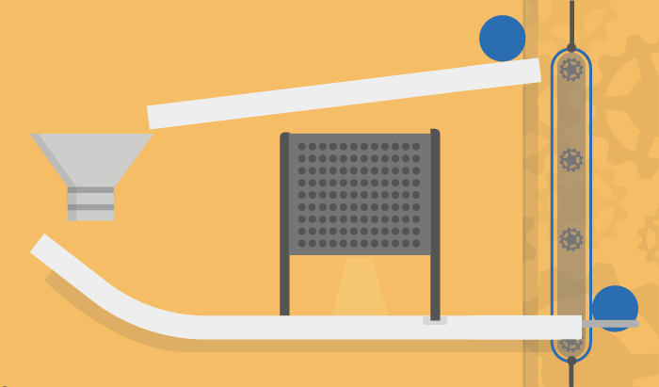

Slide 5


Software Test Procedures and Methodologies
MAD 5234
Peter Sigurdson
Cestar College Toronto
2020 Fall Term

Slide 6
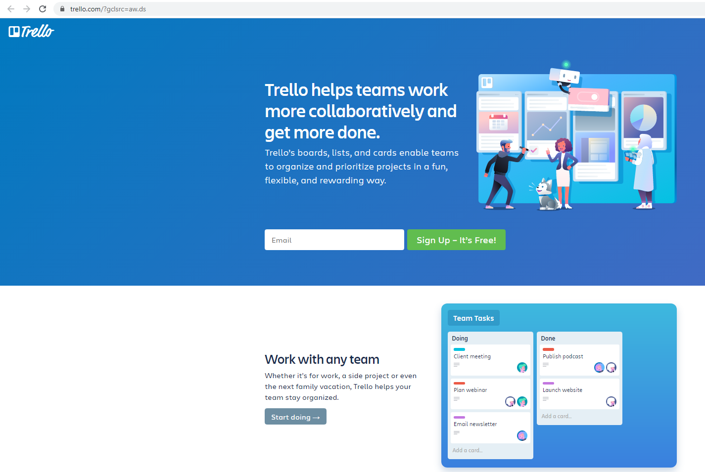
Trello is an inexpensive and effective way to manage your Agile Software Development Tasks
Trello is based on the Kanban model of moving cards around to keep track of tasks and resources

Slide 7
The major reason of software failure is 80% - lack of clear understanding of customer requirements.
Which is why we Agile Best Practices Design Guide
Use Cases are the communication vehicles for giving all stakeholders the opportunity to be aware of the project status, and to give their input
Stakeholder is anyone who has any involvement or concern in the system we are building:
People paying for it: Executive Champion
Any users, customers, anyone else who will be using or getting value from the system: any parties concerned with the operation of that system.

Slide 8
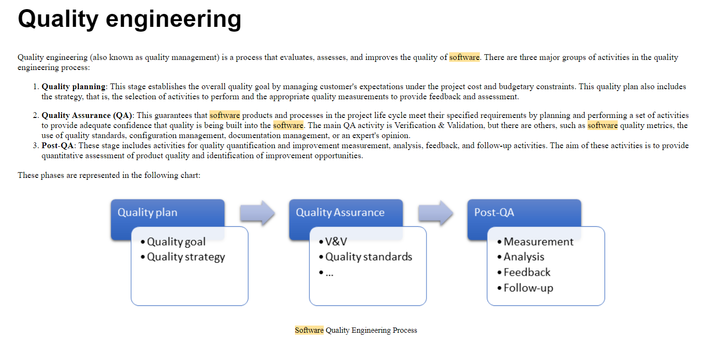

Slide 9
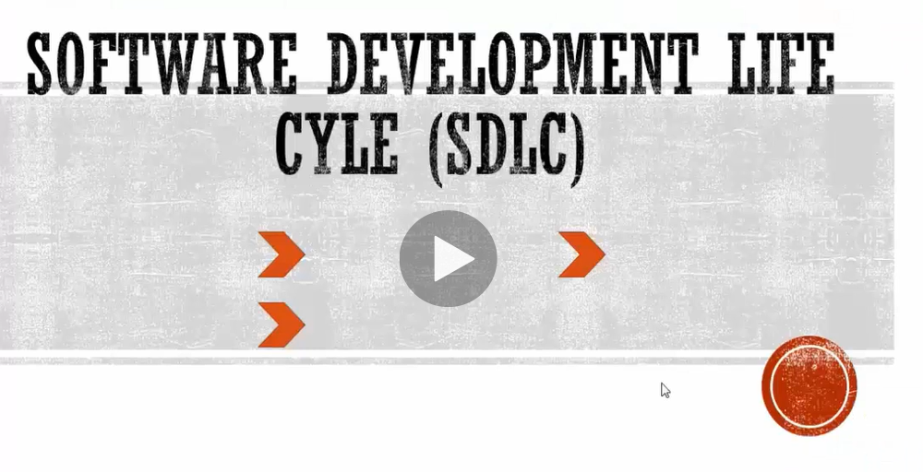

Slide 10
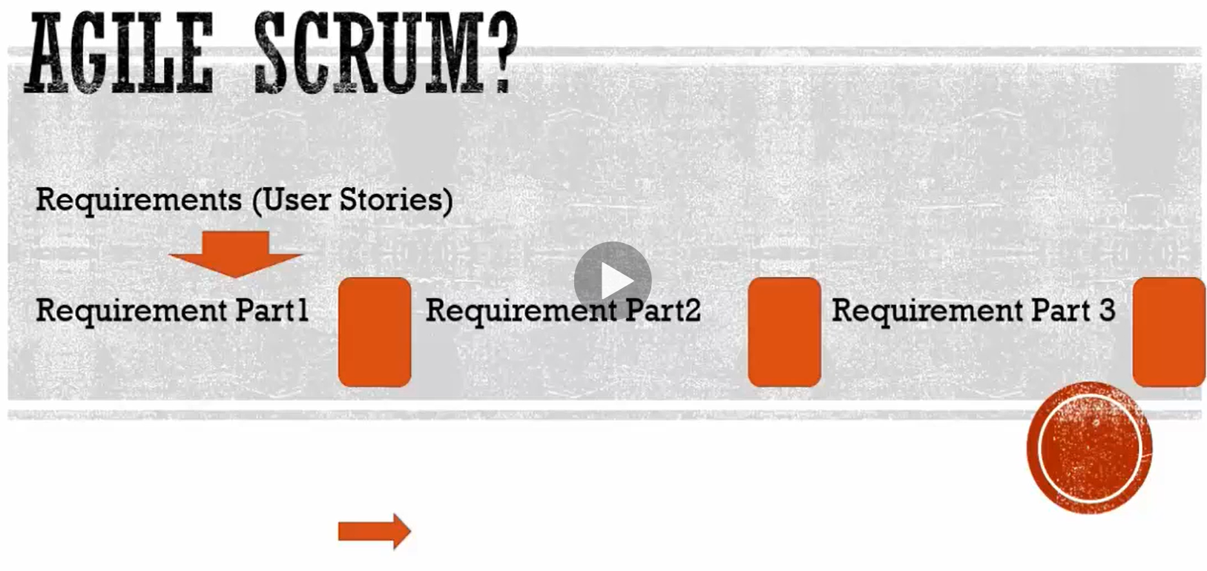

Slide 11

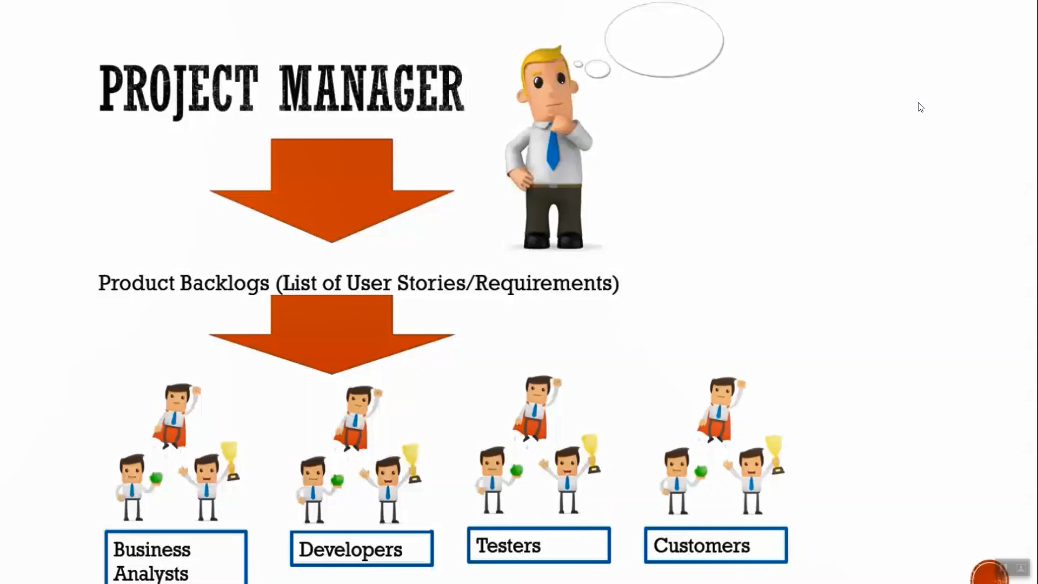

Slide 12
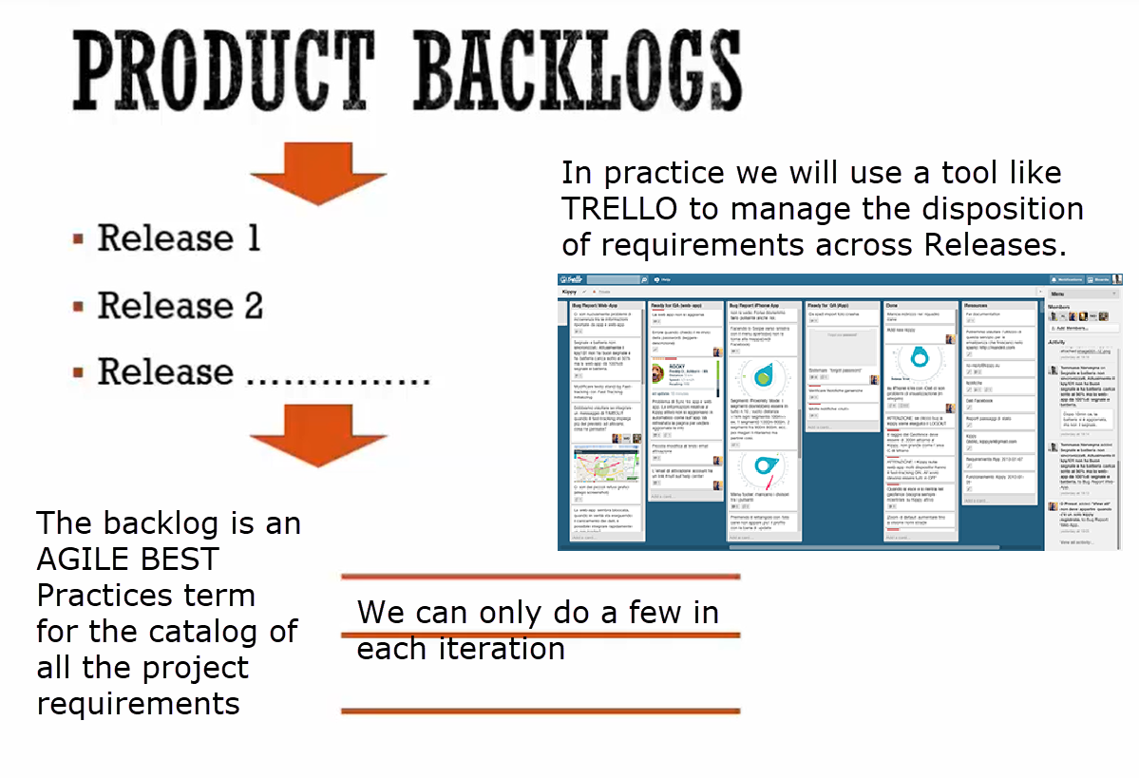

Slide 13
When do we do testing?
when do we test???
ALWAYS
AS SOON AS WE GET THE IDEA FOR A PROJECT:
WE WRITE TESTS FIRST!!!!!
TESTS HAVE 2 PURPOSES HERE IN AGILE LAND!
VALIDATION CORRECT OPERATION (from 1950s)
new =- Agile: We use testing for specification! to define/describe/create the look, how it’s put together- nature of our application

Slide 14
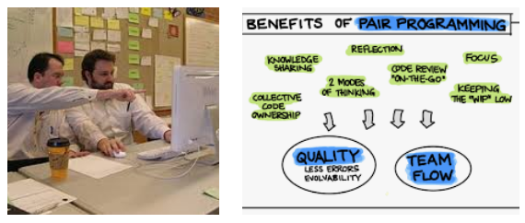
When do we do testing?
Beginning / INCEPTION phase: SPECIFICATION
We conceptualize / come up with TESTS as a way of organizing our own thinking
METHOD UNIT TESTS: we create state tables to specify the expected result of methods based on the data state of the input parameters
Integration TESTING: modules communicate correctly
Externalities/System testing: take input from outside, send back the required outputs
User Acceptance Testing:
Appearance, colors, spelling, overall look and feel, flow of the application
Software testing lifecycle
Agile means:
We write test cases BEFORE we write code. Use use TEST WRITING as part of building the design specification/ architecture.
We test frequently – after every SPRINT. Sometimes even within a SPRINT. Sometimes a User Advocate sits beside the program and gives approval / direction as the code is being written.

Slide 15
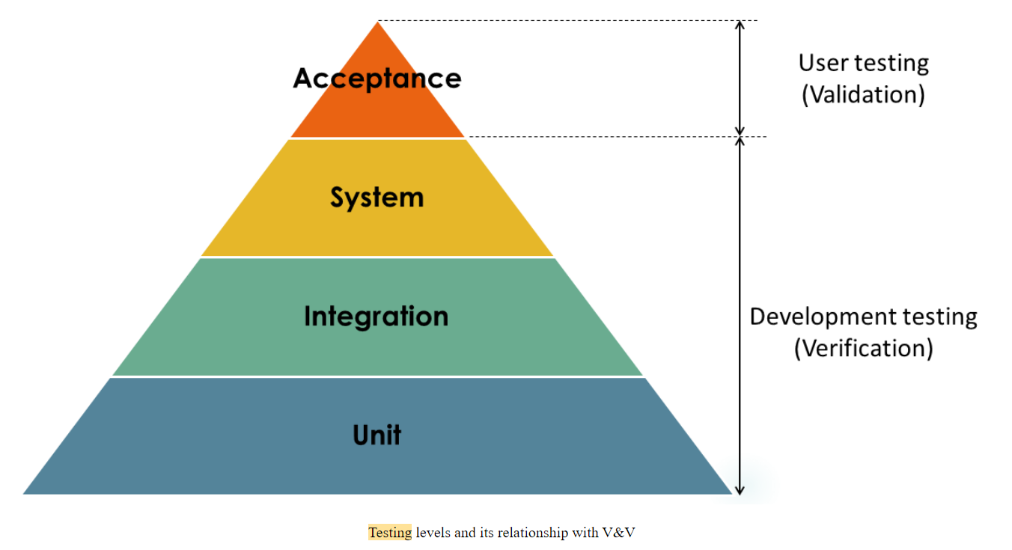
When do we do testing?

Slide 16
System testing
System testing during development involves integrating components to create a version of the system and the testing the integrated system. It verifies that the components are compatible, interacts correctly, and transfer the right data at the right time, topically across its user interfaces. It obviously overlaps with integration testing, but the difference here is that system testing should involve all the system components together with the final user (typically impersonated).
There is an special type of system testing called end-to-end testing. In this approach, the final user is typically impersonated, that is, simulated using automation techniques.

Slide 17
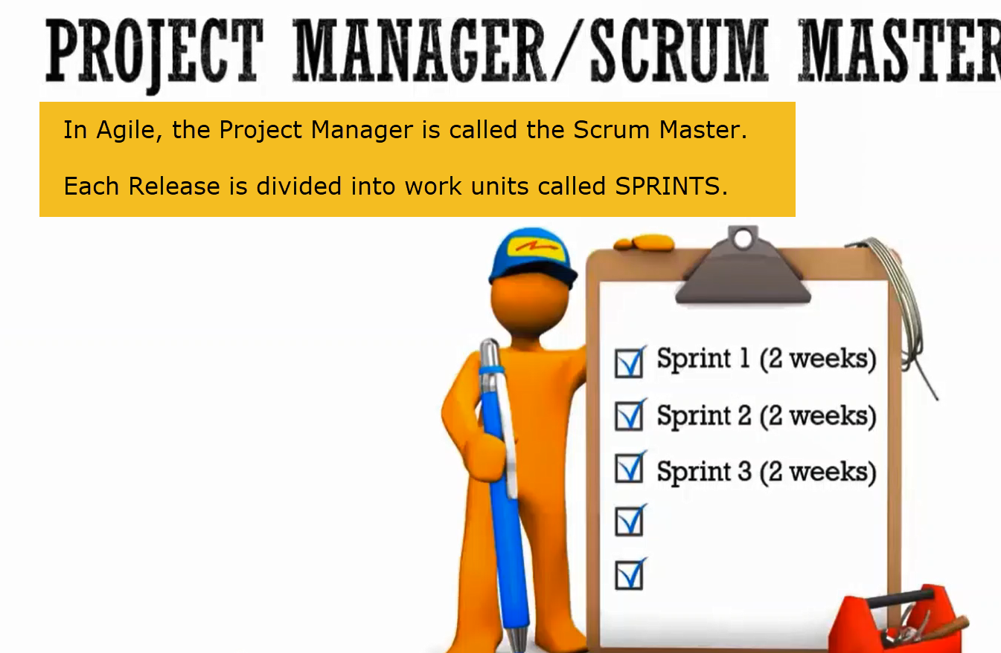
When do we TEST?
Before the beginning.
Continually during code writing.
At the end. (User Acceptance Certification)

Slide 18
Software Bugs: SOFTWARE TESTING METHODOLOGIES
Bugs are objective empirical observations of how a software system operates
To be good at the job of software testing and quality assurance, you must continually work to increase your understanding of bugs:
Types of Bugs
How they Occur
Where they occur:
Within a Module (Unit Testing): The operation of Methods and Functions, and the way Data Fields are constructed and used.
Between Modules: (Integration Testing): How are modules communicating and accessing shared dictionaries and lookup tables of values.
The System with the Outside world: (System Testing):

Slide 19
What is a “bug”:
Most bugs are a failure in design.
Failure to deliver the expected User Value.
Bugs are failures in the expected execution path.
Other factors can degrade the Quality of the Product:
A bad User Experience. Spelling mistakes and poor color choices are examples of bad UX.

Slide 20
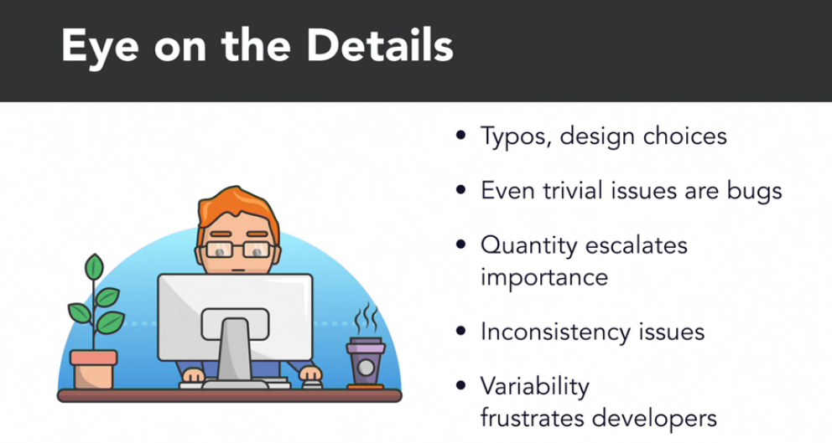
UAX: USER EXPERIENCE AND CLIENT ACCEPTANCE TESTING
A product should present consistent outputs in response to specified sets of input conditions.
What are some of the reasons why this might not occur?

Slide 21
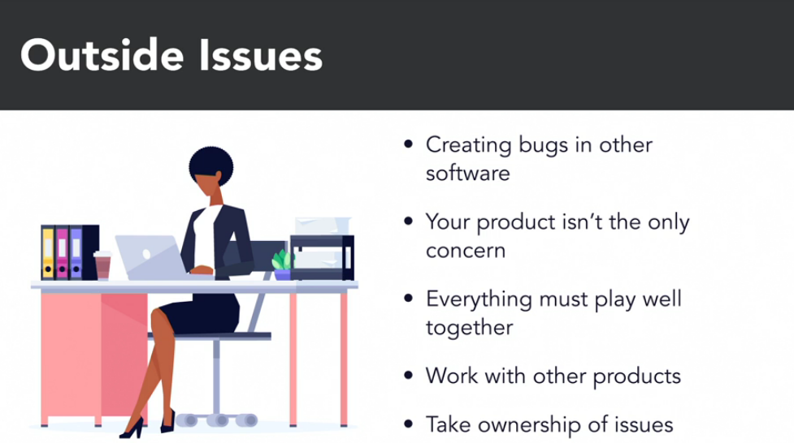
Systemic interactions and the Law of Unintended Consequences:
Whose fault is it if an Operating System patch causes your Product to fail or deliver inconsistent results?

Slide 22

Performance Issues:
OPERATING SYSTEM LEVEL AND SERVICE PACK
DATABASE VERSION AND SERVICE PACK
NETWORK / TUNING: MUST HANDLE BANDWIDTH AND CAPACITY
THE HARDWARE / CPU, MEMORY

Slide 23
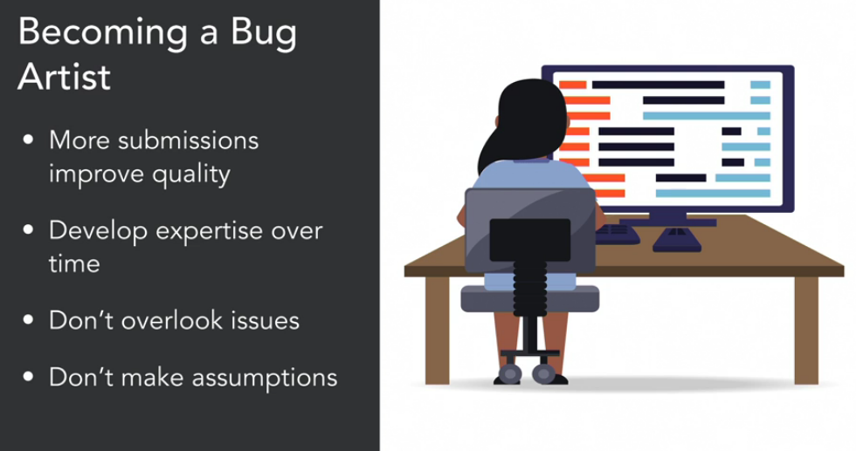
Develop the mental framework within which to trace all the execution paths in your Product back to the systemic interactions that gave rise to it.

Slide 24
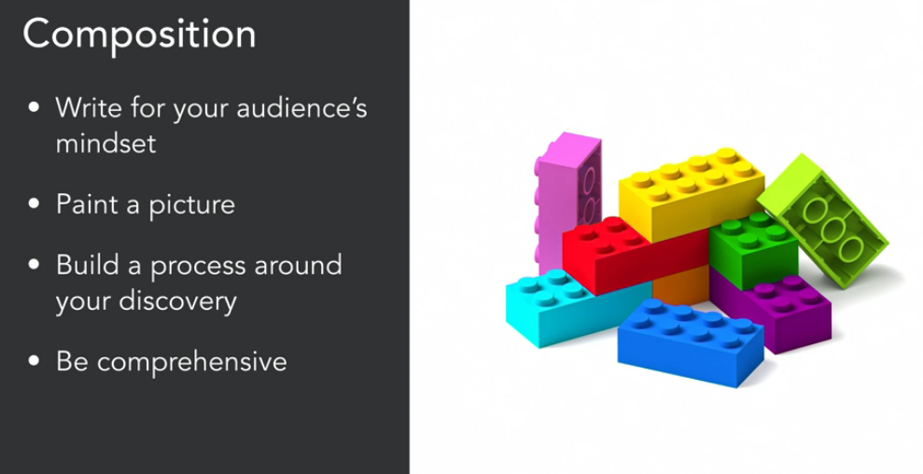
The creation and documenting of BUGS

Slide 25
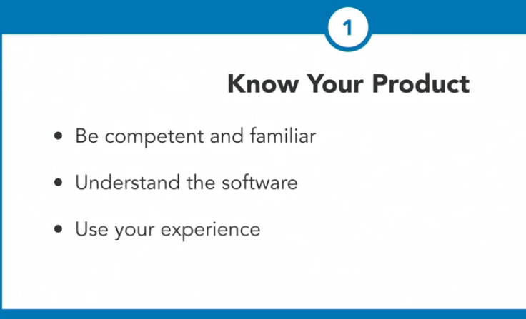
You can’t test your way out of a bad product design
Software Quality Assurance sits on top of a Product Development Stack that starts with a DESIGN and TEST CASE driven Software Architecture

Slide 26
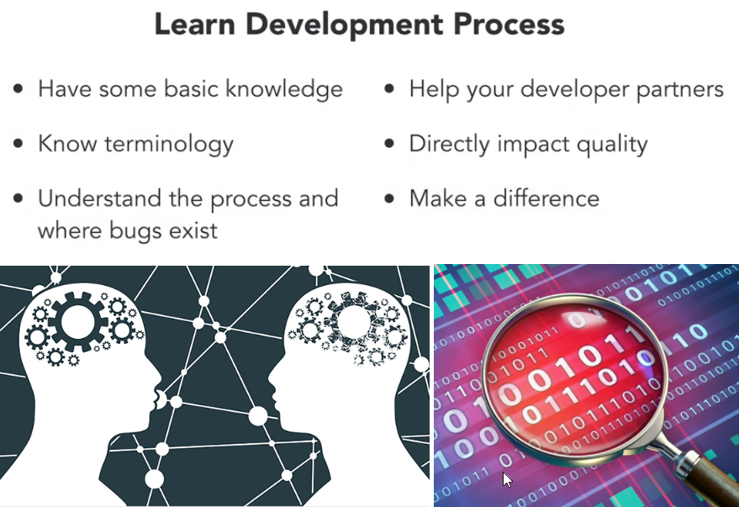
Decide to be the premier expert in your organization on how the application works and is used by customers
PROFESSIONAL DEVELOPMENT

Slide 27
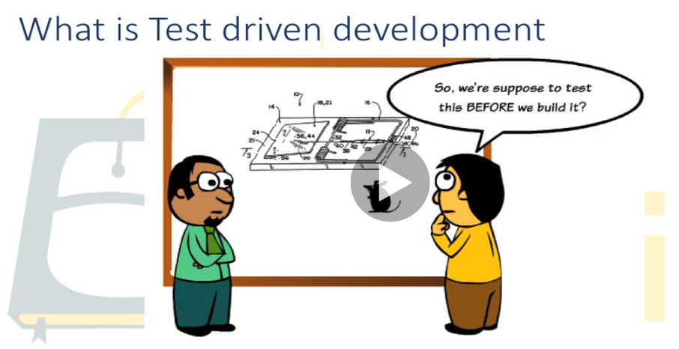

Slide 28
The two purposes of writing software tests
Specification of what the product will deliver
Validation of the design
Think about your TESTS first and your CODE second
The process leads the work, not the work leading the process

Slide 29
What if we learn so far?
Let's take a few minutes to review some of the core concepts we've studied up till now:
Testing is something that happens at the very start of the software application development process. This is supported by using a rigourous academically structured development methodology such as unified process.
We need to write our application to be testable.
We need to write our methods to easily comply with the testing requirements that we specified in our state table. Methods must have well-defined input expectations and create returns that are clear and unambiguous. If we do not have this in place there is no possible way we can write code test to test our methods.

Slide 30
Bake the strong quality design into the application right from the beginning from the conception phase before you write a single line of code.
You know that you need to have a traceability matrix so why not write it before you start coding let the design drive the code not the other way around (which is the way most programmers do it).
Use the diagramming methods of unified modelling language to visualize how data will flow around your application before you start writing code. (Object Management Group UML Certification Exam: https://utp.omg.org/ocup-2/index.htm )
Use an object interaction diagram to design how methods will communicate between objects.
A great tester starts by being a great application architect.
To be a great tester: You must know every aspect of the application design, and the toolchain that the application is running in.

Slide 31
What are the categories / kinds of software defects
What else???
Methods not communicating property:
Fix: Object Interaction Diagrams
What else???

Slide 32
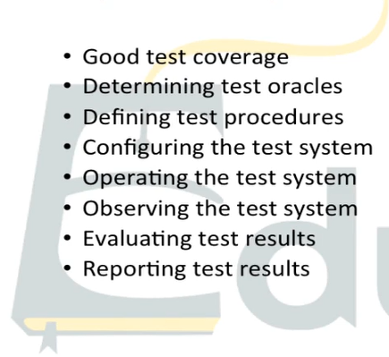
Testing Lifecycle

Slide 33
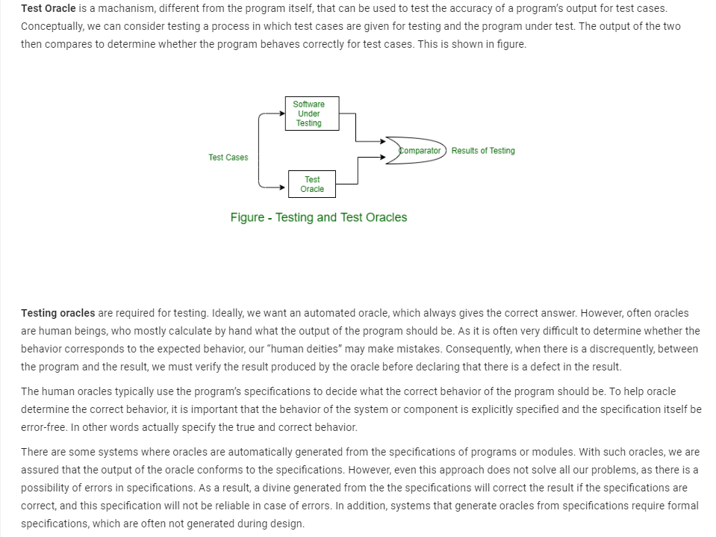
TEST Oracles

Slide 34
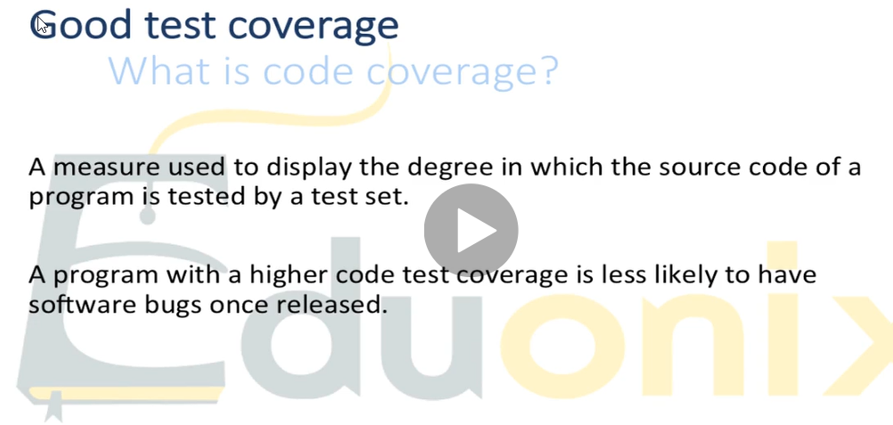
The Traceability Matrix is the design tool for designing your Test Cases.

Slide 35
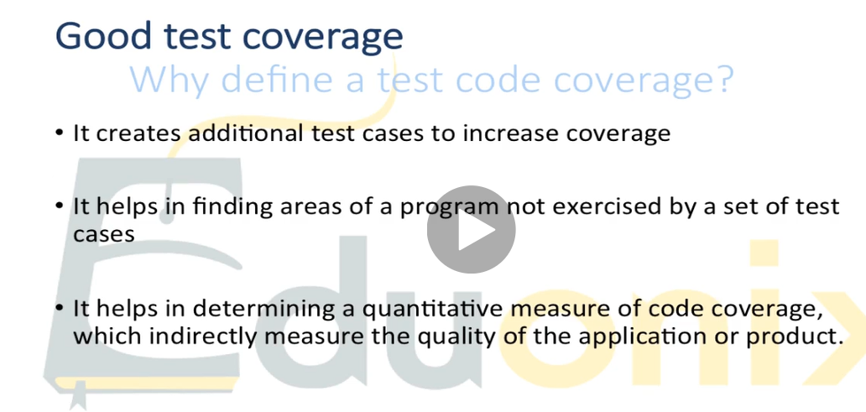

Slide 36
JUNIT TESTING

Slide 37
A basic refresher on Java Object Oriented Programming
We write Object-oriented to MODEL THINGS in the real world:
Physical, tangible object: STUDENT - our object is an Abstract Data Type ADT
The 2 ways we can contain data:
Primitive data types: int, string, double, float, char, bool
We make OBJECTS: to use as custom-built data containers
Construct COMMUNINITIES OF COMMUNITIES OF OBJECTS:
HOW DO I CONNECT OBJECTS – HOW DO I GET THEM TO COMMUNICATE AND RELATE WITH EACH OTHER:
Inheritance
composition
See my Github for a simple comprehensive example well-documented example of a Java Application demonstrated composition and inheritance, with a video:
https://github.com/computationalknowledge/JavaLevel1

Slide 38
A basic refresher on Java Object Oriented Programming
#todo: Deliver a section on High Cohesion and Low Coupling as good design heuristics for constructing and assembling your community of objects

Slide 39
A basic refresher on Java Object Oriented Programming
Construct COMMUNINITIES OF COMMUNITIES OF OBJECTS:
HOW DO I CONNECT OBJECTS – HOW DO I GET THEM TO COMMUNICATE AND RELATE WITH EACH OTHER:
Inheritance: Java gets some of the design benefits of multiple inheritance by using Interfaces
composition
Inheritance: child classes get access to the Data Variables and methods of the Parent Classes
Feline
housecat
tiger
lion
Composition: We get access to the methods and data fields of another class by:
1. Creating an OBJECT REFERENCE to that class, OR
2. We can make call STATIC FIELDS and METHODs against the Class Name

Slide 40
4 kinds of FIELDS (variables) in OO Programming:
Class Instance Variables: each object instantiated from that Class will have its own VERSION of the data
Class STATIC Variables: ALL Objects instantiated from that Class will reference the same memory location – all the objects will point to the same data, same memory location
METHOD local Variables: have scope (visibility) ONLY WITHIN that method
LOOP Local Variables: Meaning the scope – the visibility of the variable will be restricted to ONLY within that LOOP
In terms of software quality engineering, and quality assurance => we understand the importance of maintaining good encapsulation by making all Data Fields Private – and accessible ONLY by public get and set methods

Slide 41
Unit Testing
How to generate test cases for "replace a string" method?
a) If characters in new string > characters in the previous string. None of the characters should get truncated
b) If characters in new string< characters in the previous string. Junk characters should not be added
c) Spaces after and before the string should not be deleted
d) String should be replaced only for the first occurrence of the string

Slide 42
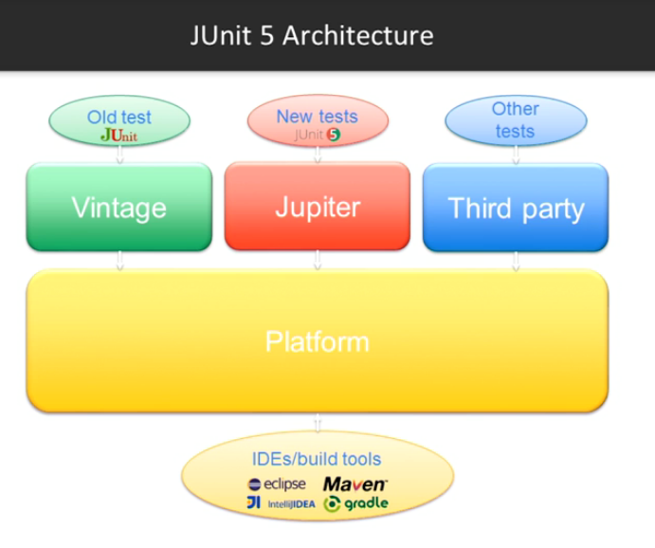

Slide 43
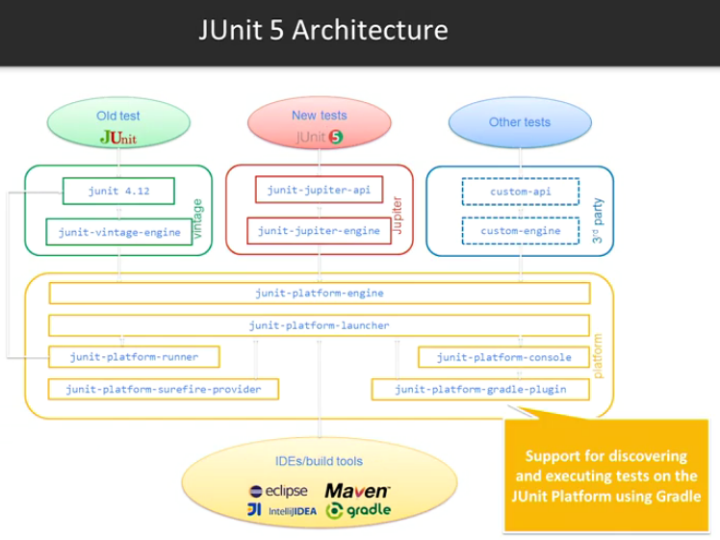

Slide 44
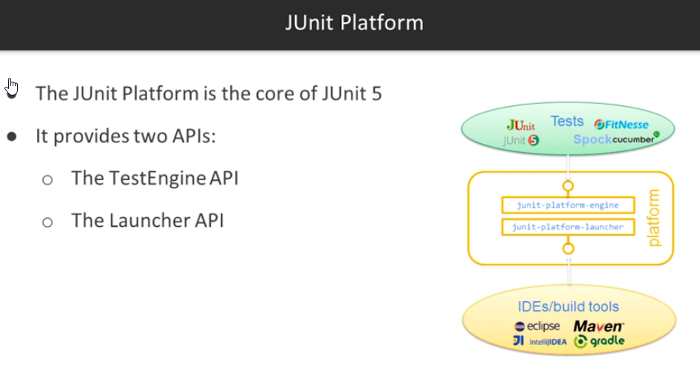
An Application Program Interface is:
A public, documented, specified set of METHODs which are publicly available to hook into the application
The API Method provides SERVICES
The Api Methods allow you to HOOK INTO the application and make sure of those services in your own code

Slide 45
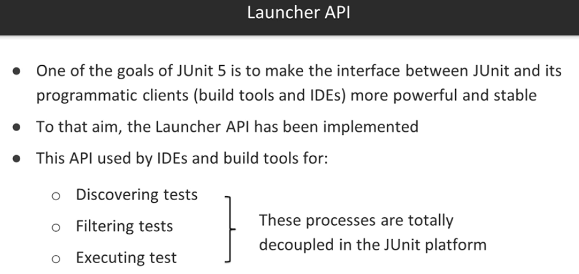

Slide 46
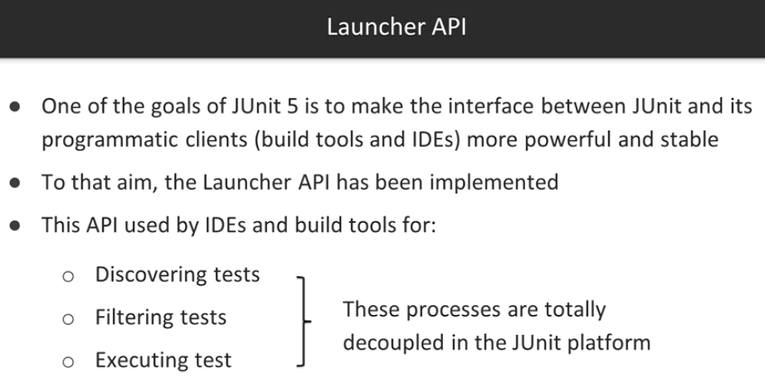

Slide 47

JUNIT is a Test Harnessing Framework
You put your code in a “harness”
The Testing Method runs and uses assert statements to determine if the presented output is the same as what you specified it should be.

Slide 48
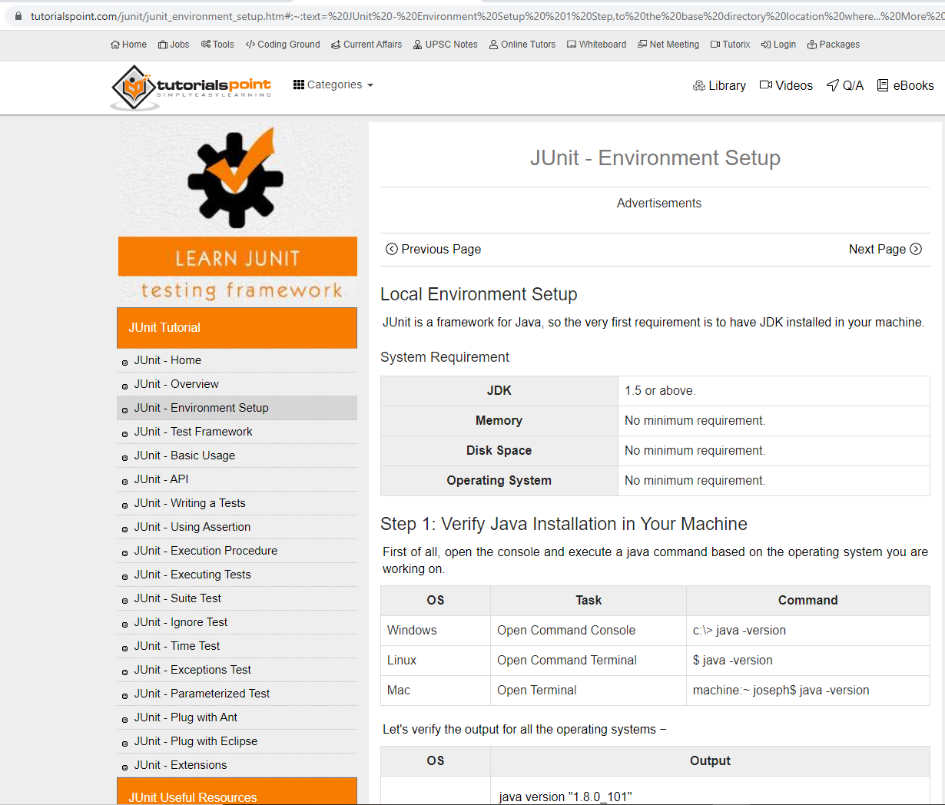
Setting up JUNIT.jar in your own environment
To install a Java Library – to be available for use with your Java Runtime Environment: putting the jar file on your Operating System’s class path
If you wanted to write Java code to sqlite database, you would get the jar file (java archive resource – it is just a Zip file) for SQLite
A simple workaround to modifying the class path is to put the jar in the same directory as your Java class file: as the JRE looks locally (current directory) before looking on the classpath.
https://www.tutorialspoint.com/junit/junit_environment_setup.htm#:~:text=%20JUnit%20-%20Environment%20Setup%20%201%20Step,to%20the%20base%20directory%20location%20where...%20More%20

Slide 49
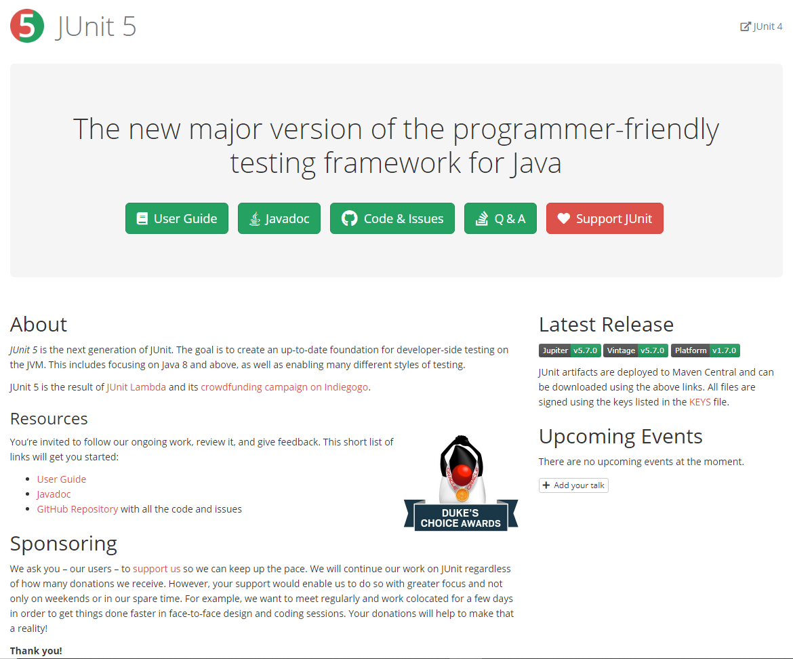
JUNIT WEBSITE https://junit.org/junit5/
https://junit.org/junit5/docs/current/user-guide/

Slide 50
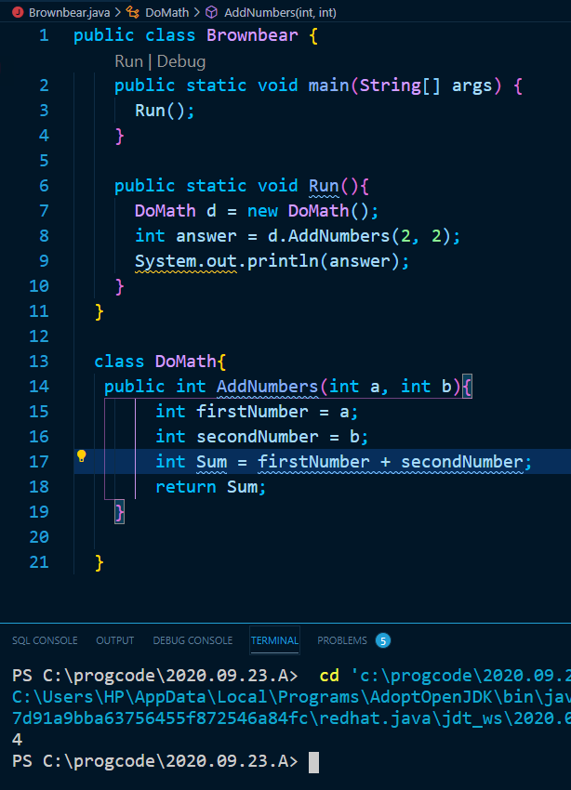
A simple example done in Visual Studio Code:

Slide 51
Review the build tools and integrated development environments which fully support JUnit5
We are going to introduce the GitHub repository in which the source code of the examples is hosted. At the time of this recording, the unit platform can be launched by three different tools: Maven, Gradle, and IntelliJ.
It's important to remember that JUnit5 requires Java 8 at runtime; however, you can still test code that has been complied with previous versions of the Java development gate. Let's see several examples about each tool. Regarding Maven, first we need to define the Junit jupiter API dependency in our pom.xml file. Then the Maven Surefire Plugin has to be declared.
Internally, this plugin needs the Junit platform Surefire provider to discover tests and the jupiter tests engine to execute these tests. Notice that all the source code of this course is available on GitHub in the repository github.com/bonigarcia/mastering-junit5. Finally, we need to create a JUnit5 test case which will be executed for example using the common Maven test.
Similarly, in Gradle we need to define the Junit jupiter API, also the Junit platform Gradle plugin, and finally the Junit jupiter engine. This time, we use the common Gradle test to execute our first Junit test. Finally, we can use IntelliJ version 2016.2 or upper to run the unit test in this integrated development environment.

Slide 52
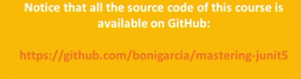

Slide 53
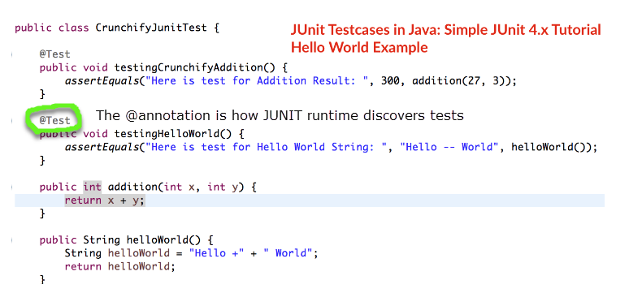

Slide 54
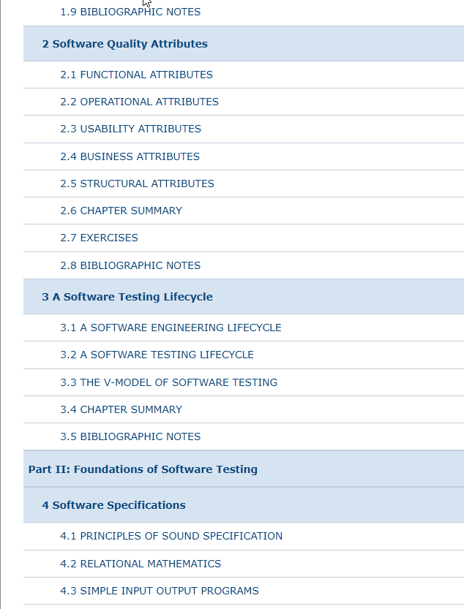
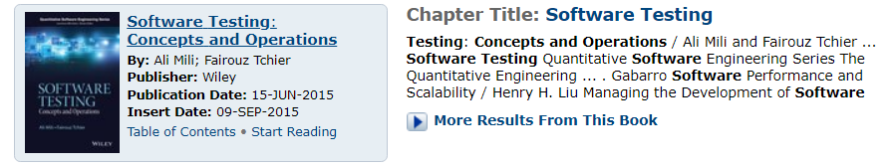

Slide 55
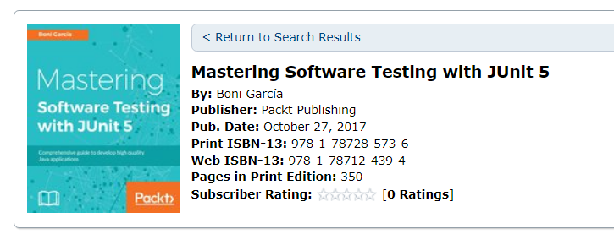

Slide 56
Assignment 1: 15% Due: End of Day SEPT 26 (SAT)
In this Assignment you will make a Video which has the intention / which will serve the purpose of teaching other people about:
1. How do we do Software Quality Design
2. How do we do Software Quality ASSURANCE
3. DEMONSTRATE/TEACH how to use JUNIT to do METHOD UNIT TESTING.
A well-constructed video lesson should be able to deliver the message in 3 to 5 minutes.

Slide 57
Assignment 1: 15% Due: End of Day SEPT 26 (SAT)
There can be up to 4 people in a team
Step 2: Create a Relational LINK to your Audience’s Interest (What’s in it for ME)
Step 3: Deliver your Lesson: screen casting, Show your PowerPoint, lecture
Step 4: Wrap up, summary, conclusion: Reinforce what you have told them: and why they are excited about it!
Step 1: State CLEAR Learning Outcomes for your Lesson!
Case Studies, Talk about how a knowledge of testing and QA practices will make them better programmers
A good simple pattern to make an Instructional Video:
Put your content into Power Point: Charts, Text, Support Visuals,
A. Save PowerPoint as a Video Clip
B. Screencast your SCREEN using your Video Software – run through your Point Point.
(Optional to do a voice narration).
(Optional to include video of your talking and lecturing).

Slide 58
Assignment 1: Grading Rubric
100% | Show excitement ; passion; enthusiasm; present new, innovative, unique concepts, insights, innovations and practices: make your presentation look like it could be the starter of a Training such as you might see on Udemy or Lynda.com
75% | Effective use of Visuals; give good clear explanations and procedures that a learner will be able to follow and repeat on their own; Good well-presented procedures and explanations
50% | Present a well-structured delivery of what software quality assurance and software testing is; Why do we do it and How do we do it
25% | Hand in on time and in the proper format
Step 4: Wrap up, summary, conclusion: Reinforce what you have told them: and why they are excited about it!

Slide 59
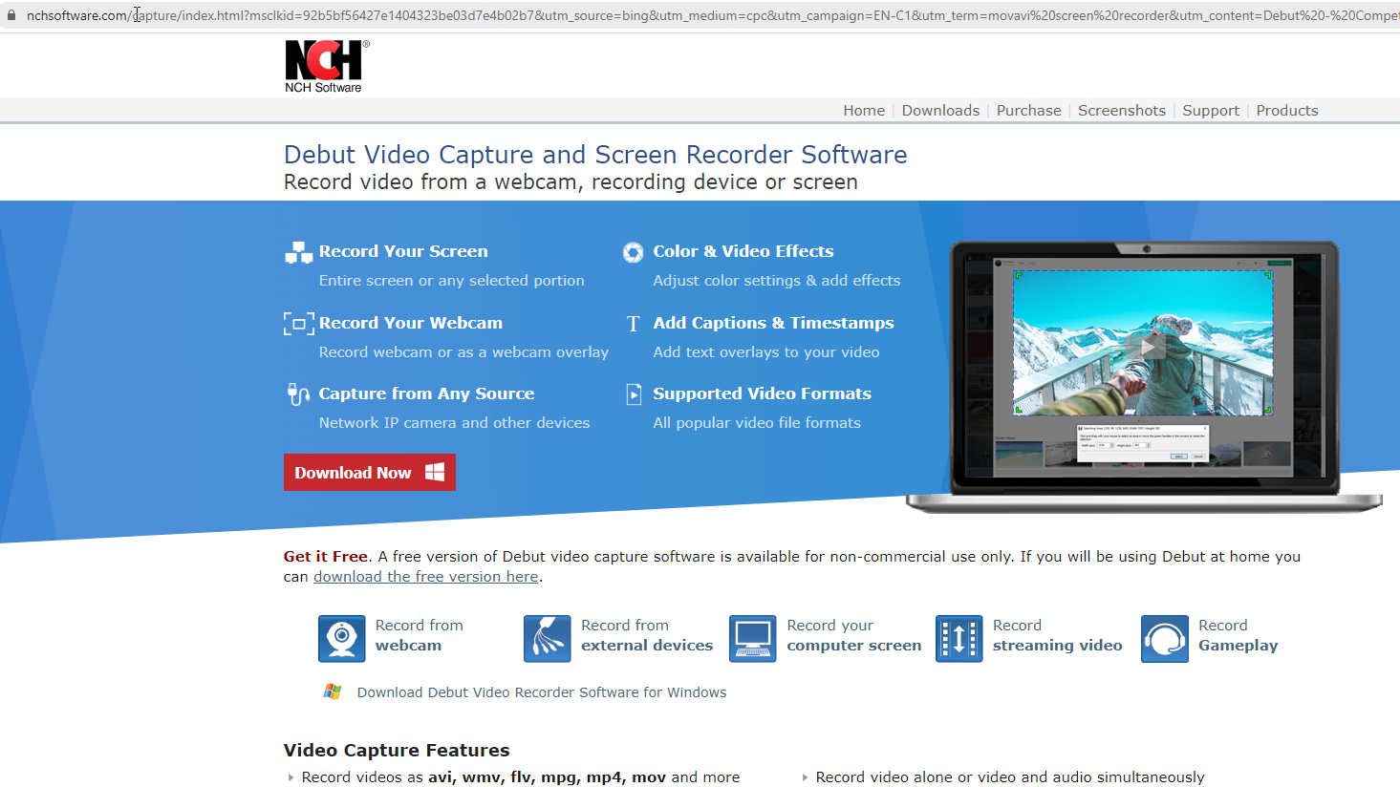
https://www.nchsoftware.com/capture/index.html?msclkid=92b5bf56427e1404323be03d7e4b02b7

Slide 60
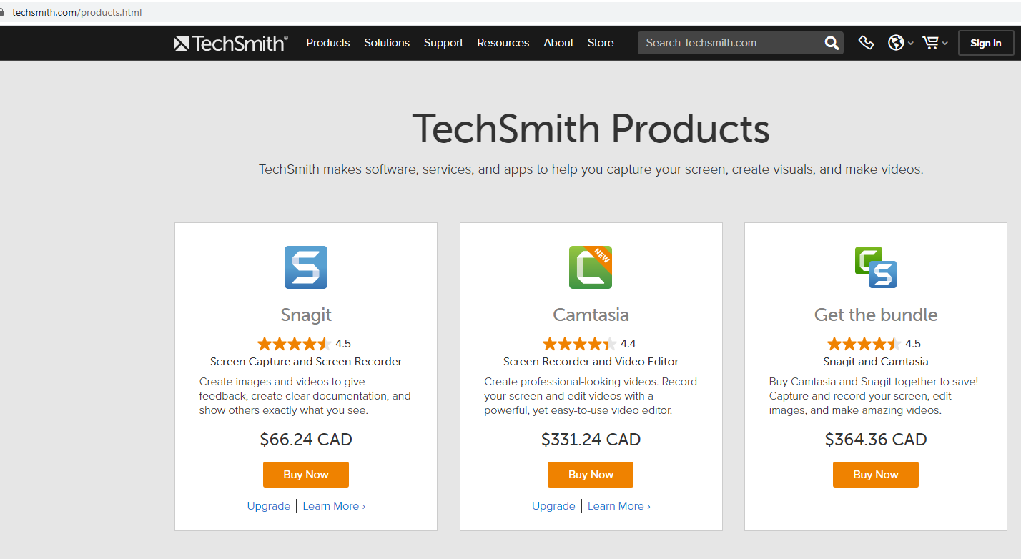
Free 30 Day Trial of Camtasia
https://www.techsmith.com/products.html

Slide 61
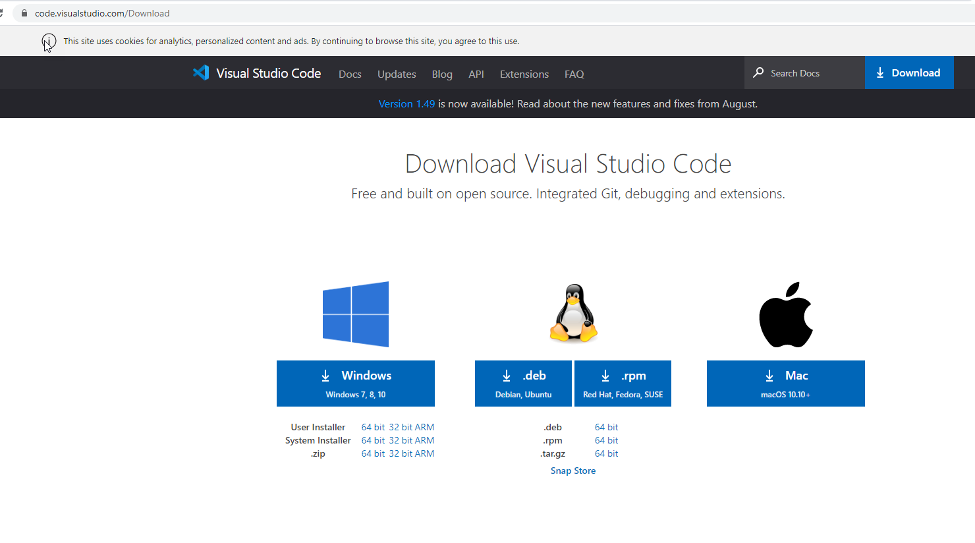
https://code.visualstudio.com/Download

